Slide 1

Report: On the importance of initialization and momentum in deep learning
Ilya Sutskever, University of Toronto, ICML 2013, ILYASU@GOOGLE.COM
Zuoyan li, CIS Lab, Shenzhen Graduate school of PKU, Shenzhen
2019.10.11 Shenzhen

Slide 2
Before starting…

Slide 3
Geoffrey Hinton
DNN 2006
Yoshua Bengio
Yann LeCun
G vanish 2010
hard in DNN 2012
James Martens
Ilya Sutskever
Krizhevsky
Ruslan Salakhutdinov
HF 2010
NAG 2013
ImgNet 2012
DNN 2006
Machine Learning at the University of Toronto

Slide 4
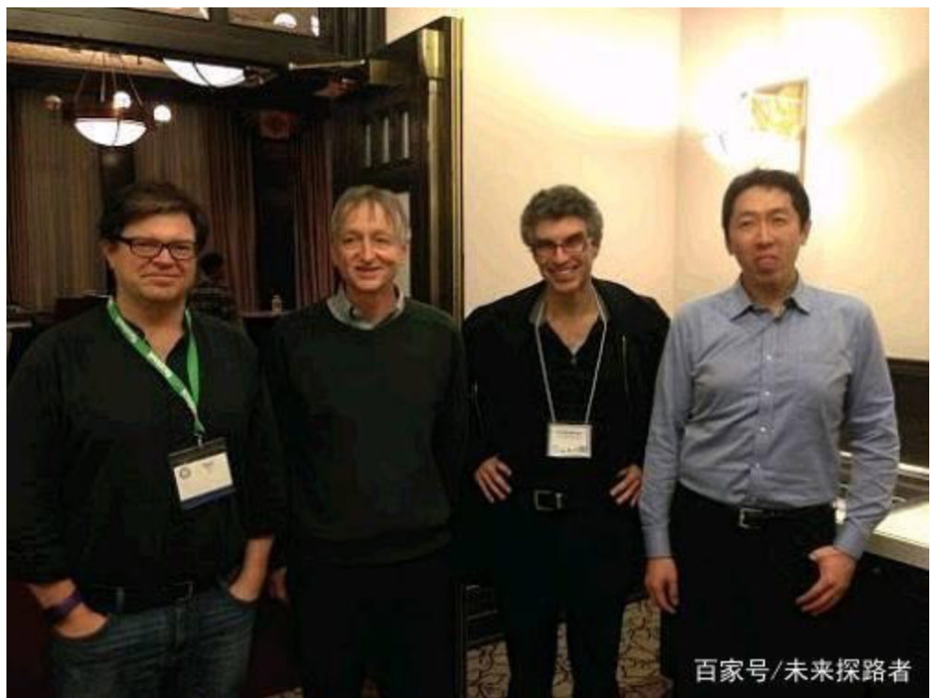
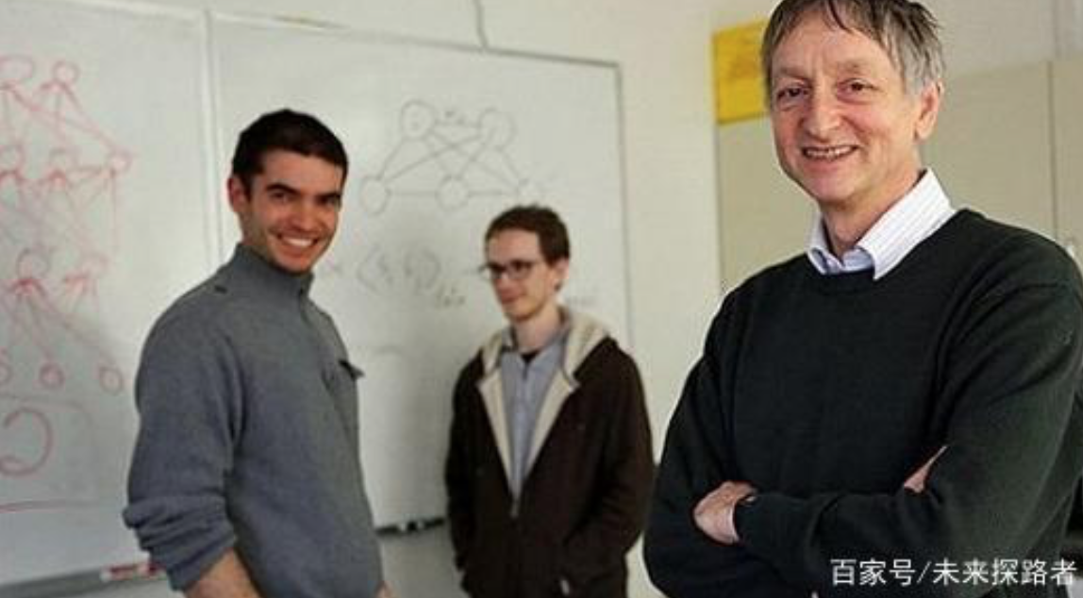

Slide 5
Some Notations

Slide 6
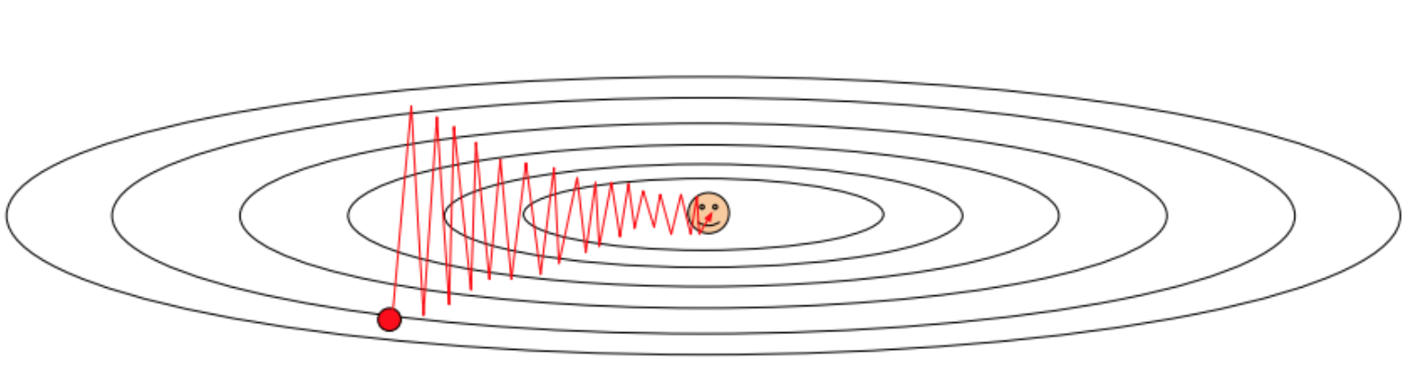
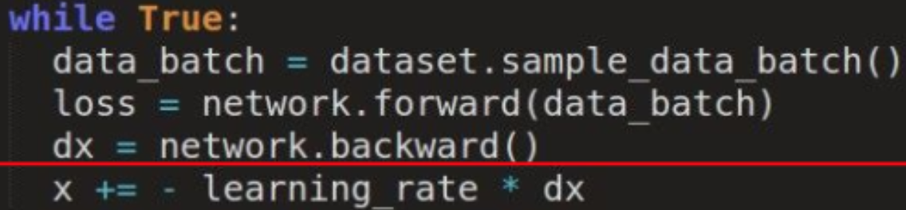
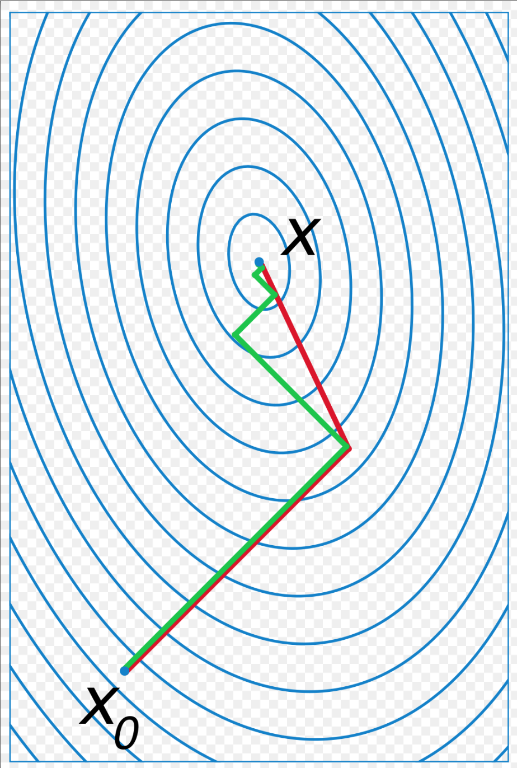
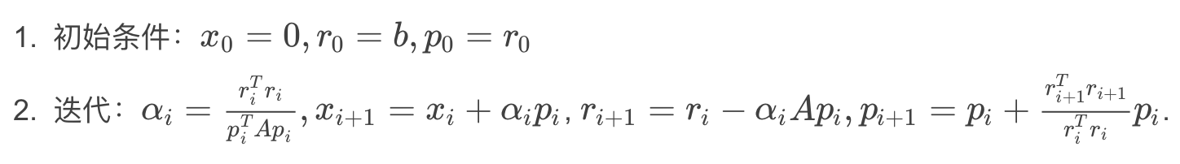
SGD: Stochastic Gradient Descent
CG: Conjugate Gradient Method
Gradient Descent
CG
Usage:
we use CG to approximately solve ∇2f (x)∆x + ∇f (x) = 0

Slide 7
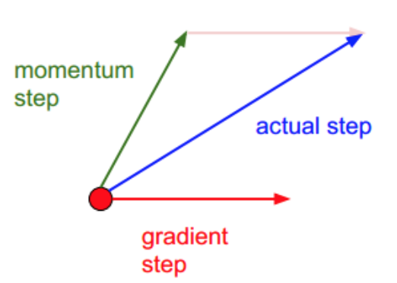
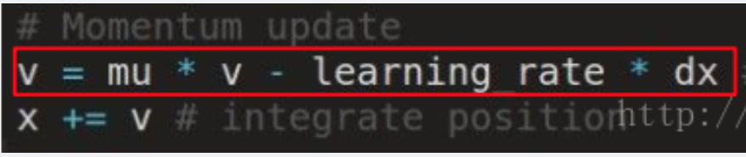
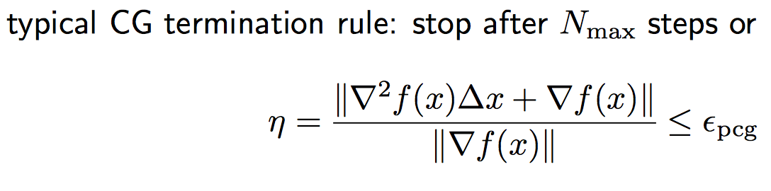
Momentum
Truncated Newton
related to limited memory Newton (or BFGS)
can handle very large problems

Slide 8
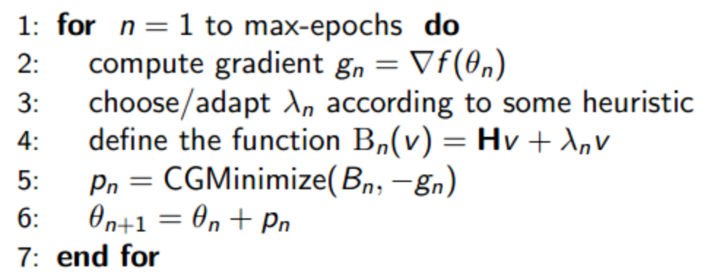
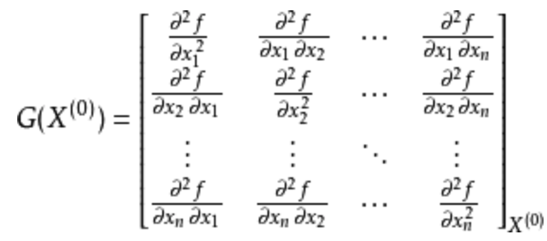
HF: Hessian-free Optimization

Slide 9
Existed Problem in DNN
About Gradient optimization

Slide 10
Others: SGD with momentum
DNN/RNN
Author: Poor init or None momentum
Network

Slide 11
Attributions

Slide 12
More thorough investigation of the difficulty of training DNNs/RNNs.
Effectiveness of SGD with well initialization and momentum-based acceleration.
Certain carefully designed schedules for the constant of momentum μ.
The vital role in training networks momentum played.
Discussion of links between classical momentum and Nesterov’s accelerated gradient method.
In theory.
In experiments.
HF acts like momentum.

Slide 13
Momentum & Nesterov’s
Accelerated Gradient

Slide 14
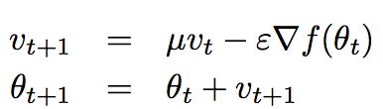
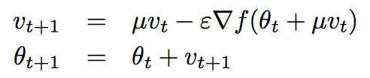
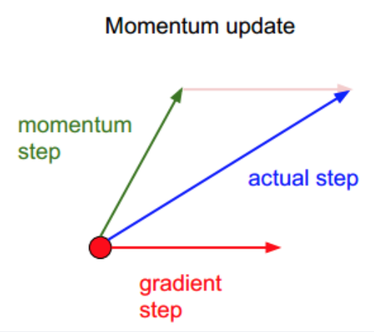
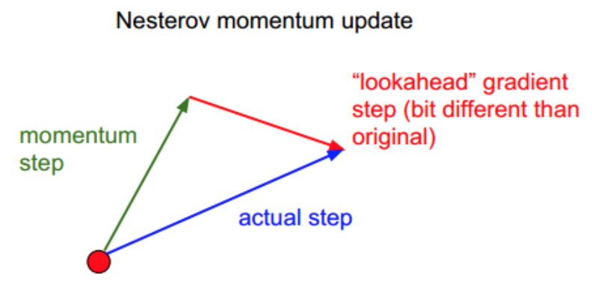
Momentum (Classical Momentum[1964])
Nesterov’s Accelerated Gradient
Generality
Both CM and NAG compute the new velocity by applying a gradient-based correction to the previous velocity vector. And add the velocity to original theta.
Disparties
One is at current position.
Another one is at ‘look-ahead’position
NAG more flexible, more stable

Slide 15
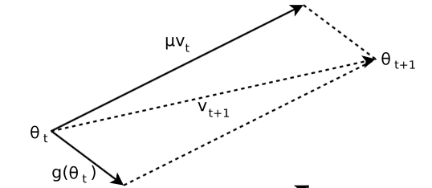
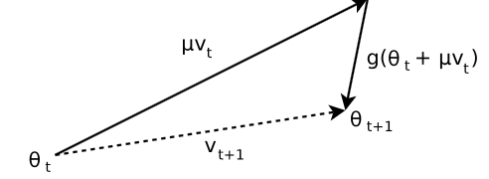
What if when u is large ？
CM
NAG

Slide 16
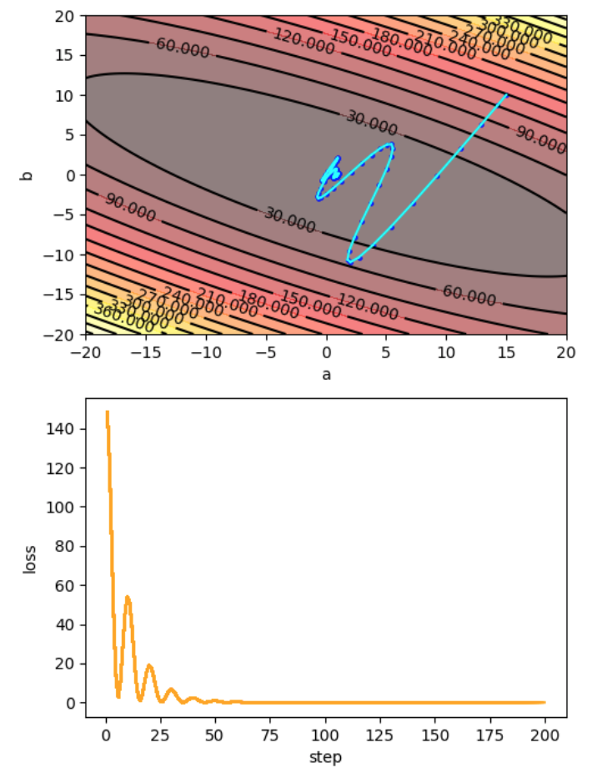
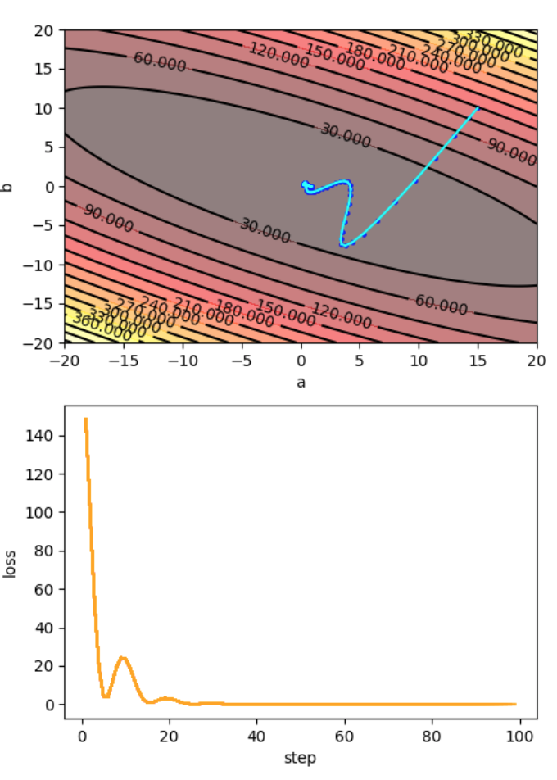
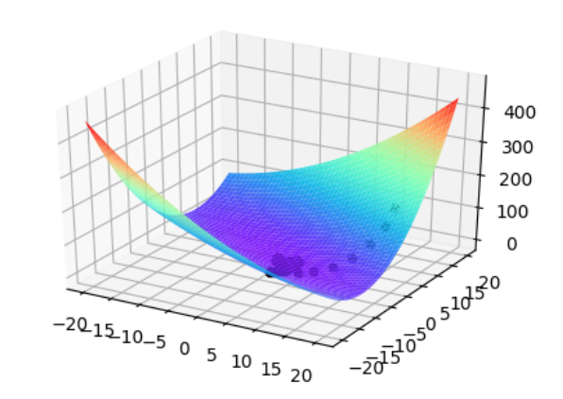
Experiment
CM
NAG
oscillations
code
Refers to…

Slide 17
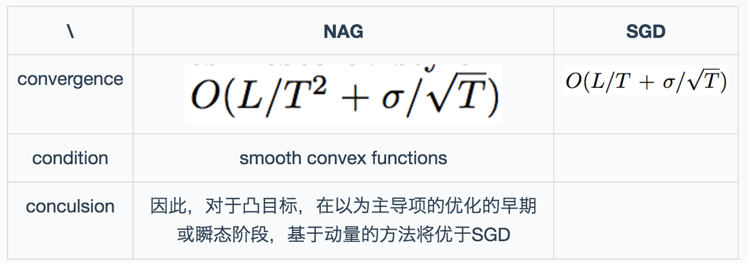
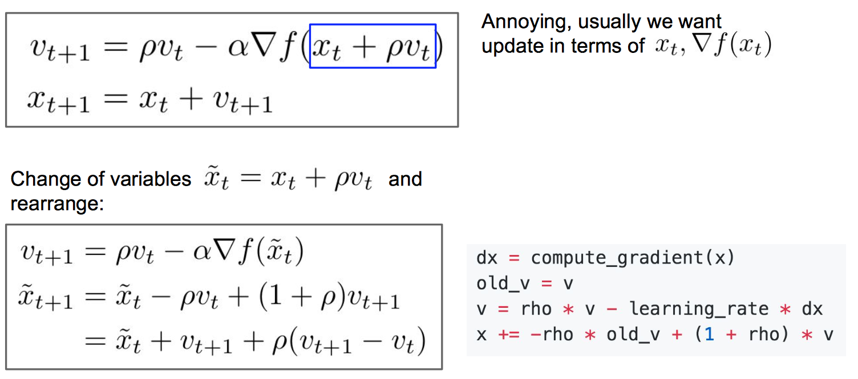
Addition

Slide 18
Discussion

Slide 19
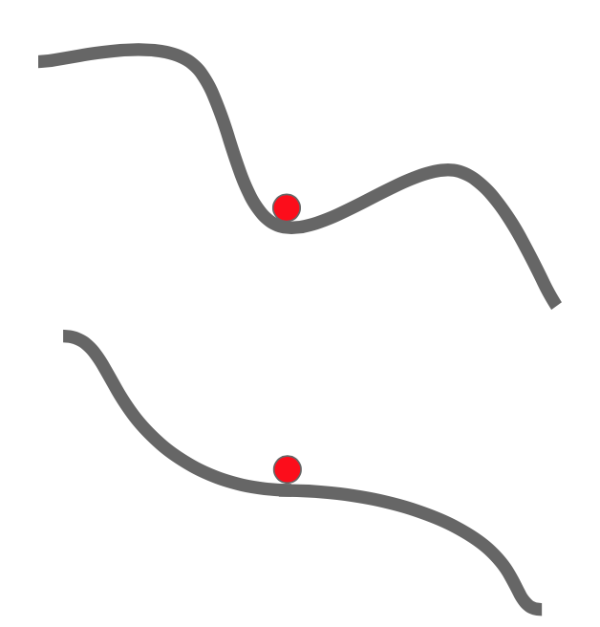
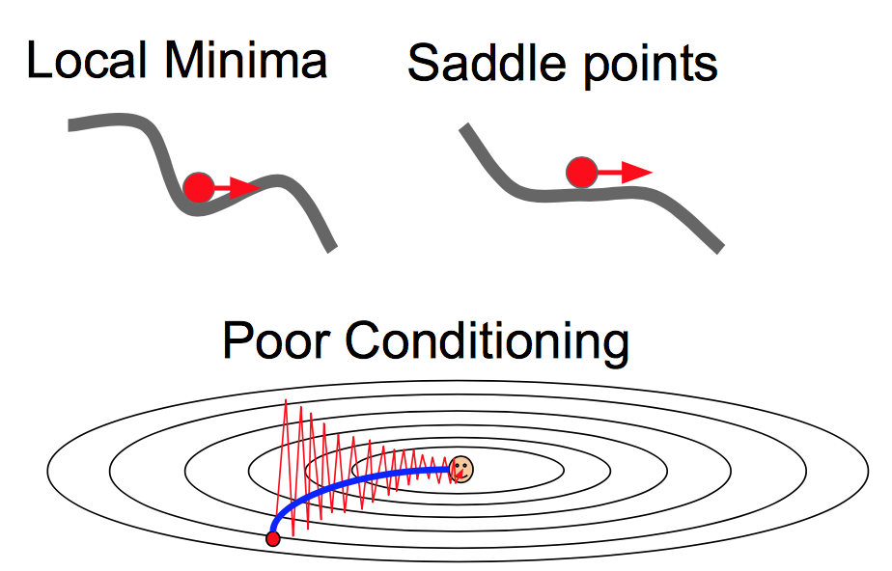

Slide 20
Thanks
Q&A

Slide 21
Investigate the performance of SGD on DNN with well initialization.
Explore the importance and effect of momentum with optimal learning rate
Compare the performance of NAG V.S CM

